Slide 1
Georectifying and Geocoding
Walkthrough

Slide 2
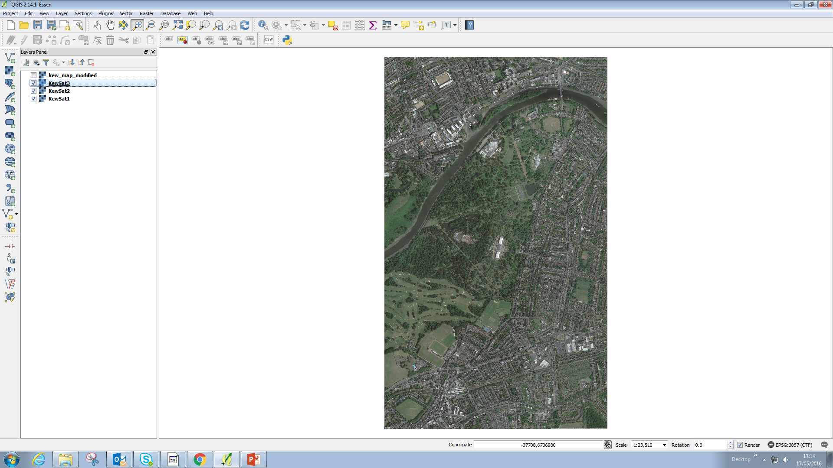
Load new project
Load KewSat1-3
Explain what the different files are
Explain what georeferencing is

Slide 3
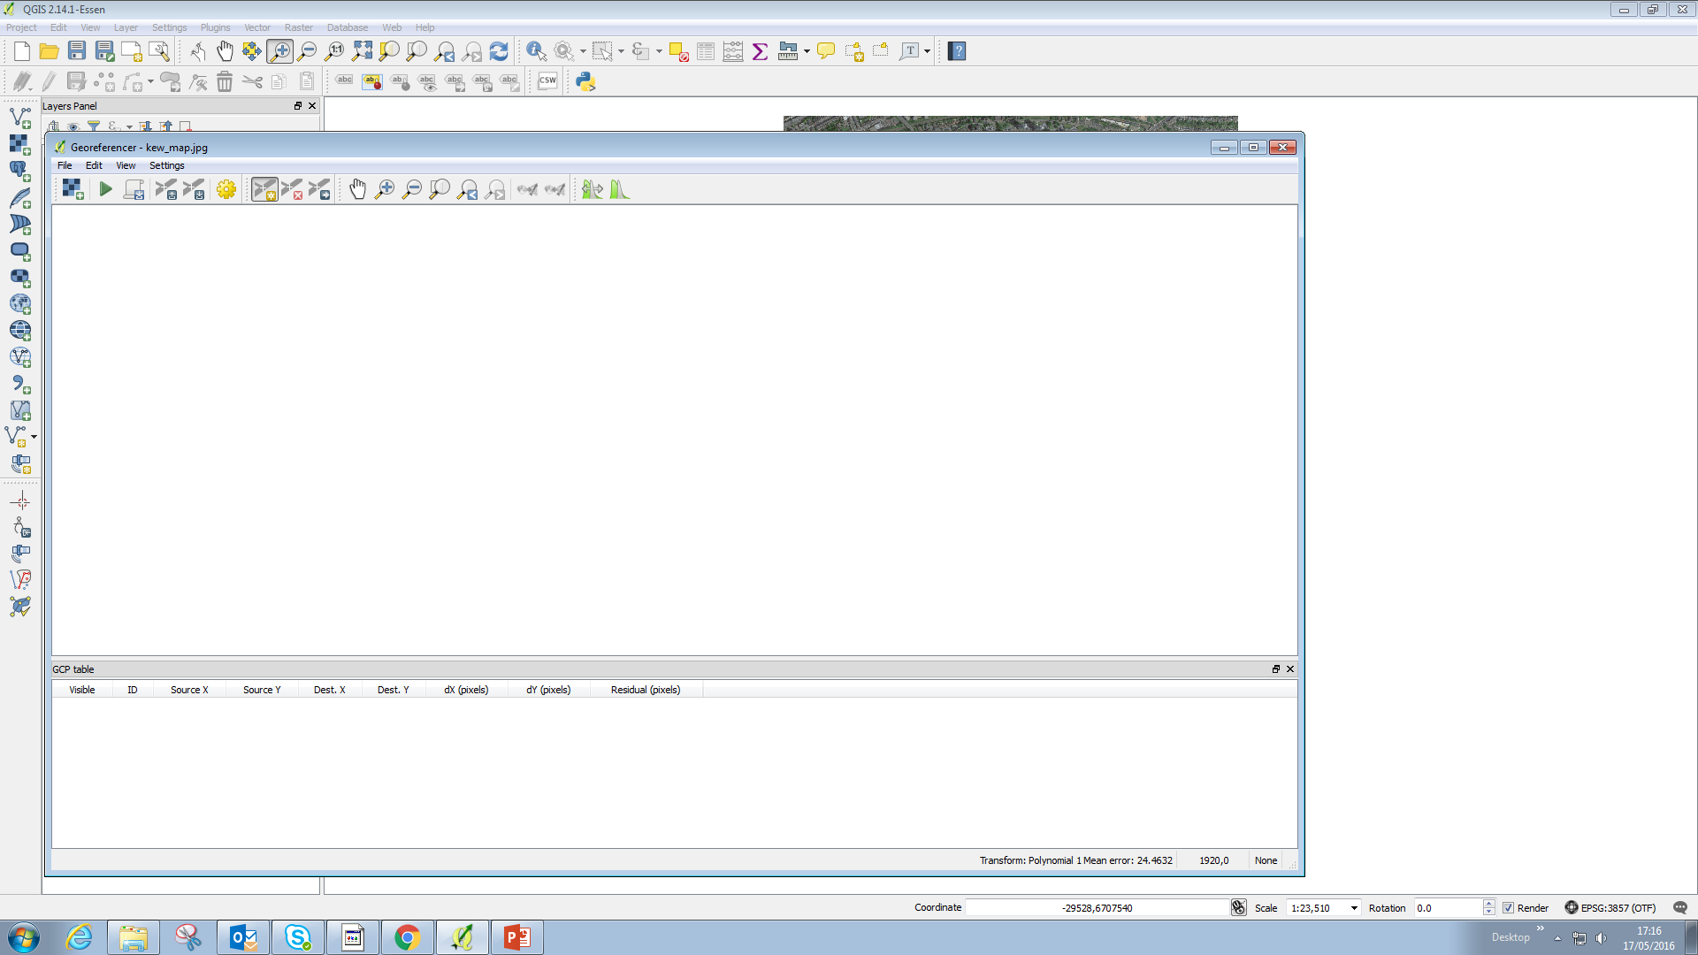
Open up Georefencer window
Raster > Georeferencer

Slide 4
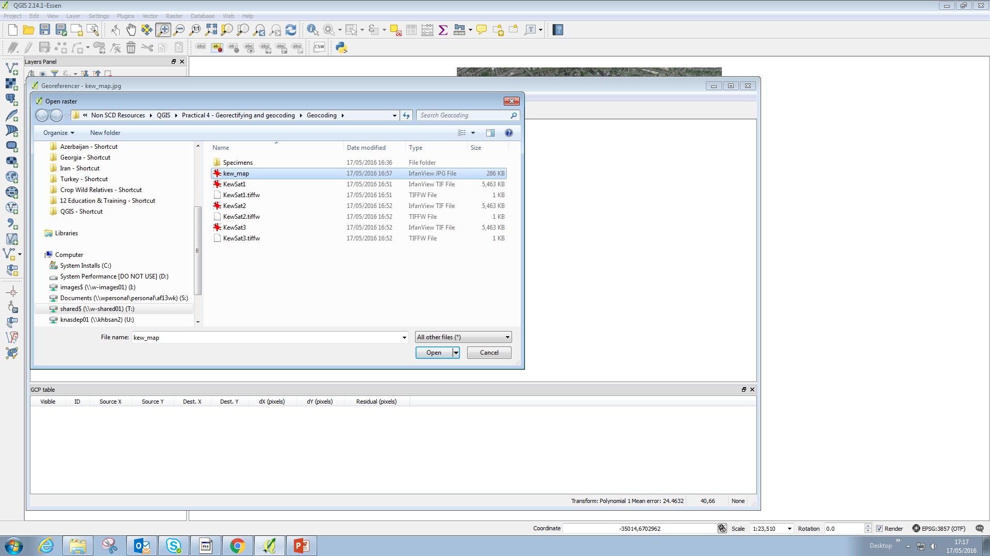
Load raster (kew_map)
CRS – pseudo merc
Add points
STOP AND REPEAT!

Slide 5
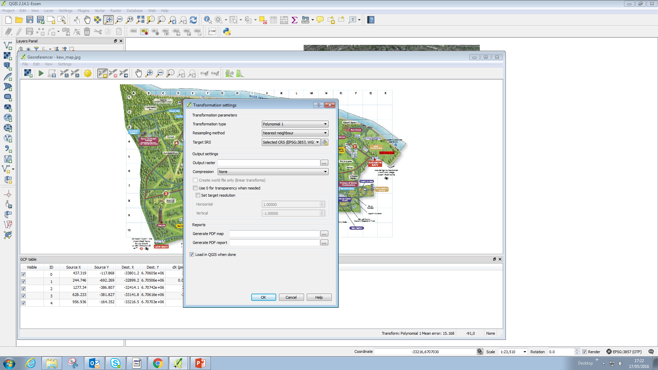
FOR EVERYONE TO FOLLOW!
Transformation settings
Poly 1
Careful with CRS!
Add raster name
OK
Press Play

Slide 6
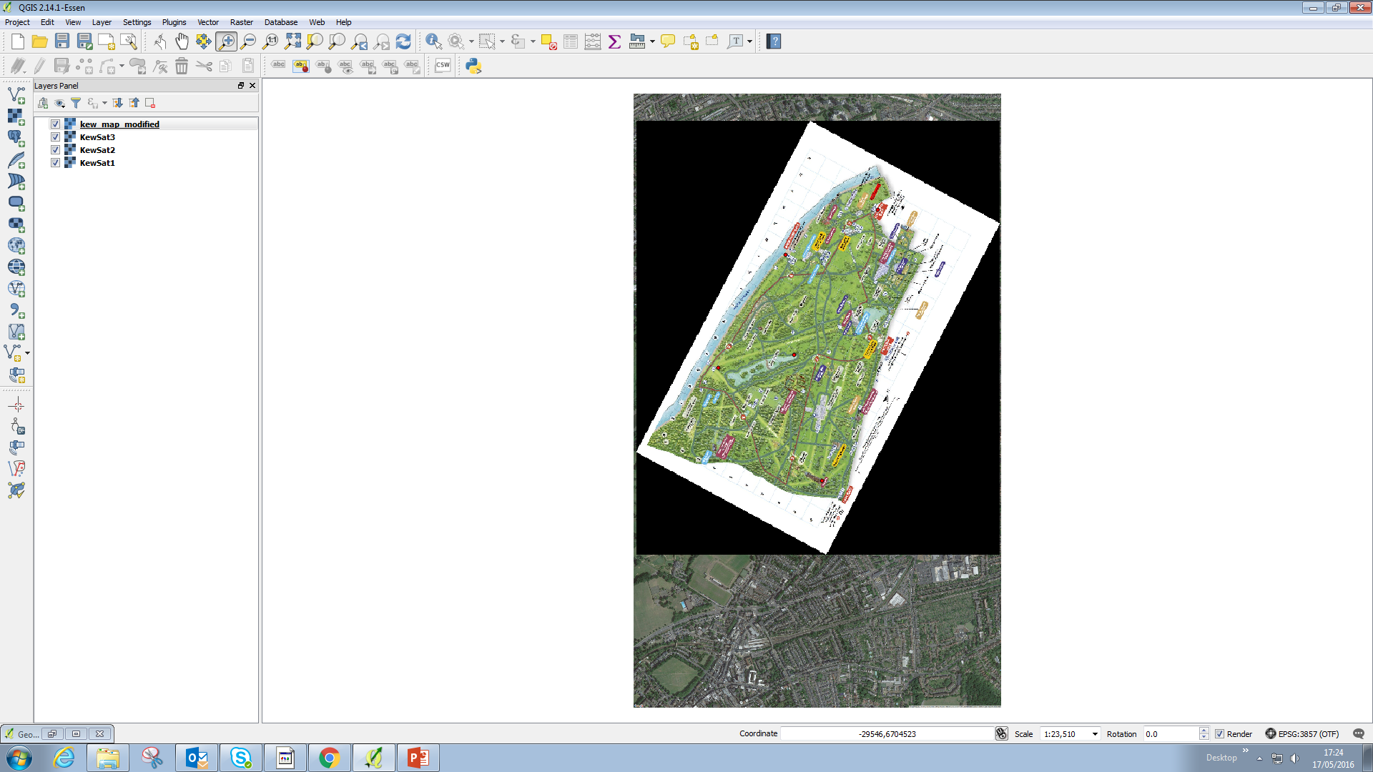
Talk about residuals
Add non sensical point
Get them to follow and then remove the point
STOP, REPEAT, SAVE PROJECT

Slide 7
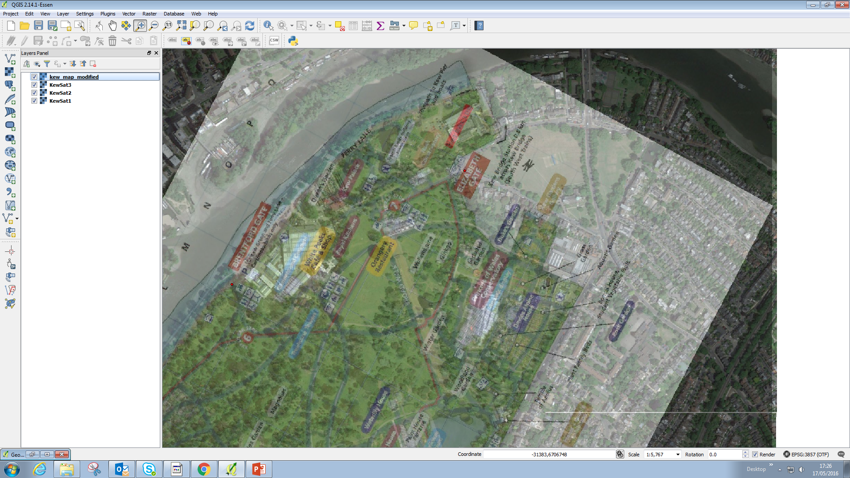
Zoom into herbarium
Set transparency to 70%
Unclick kew map layer

Slide 8
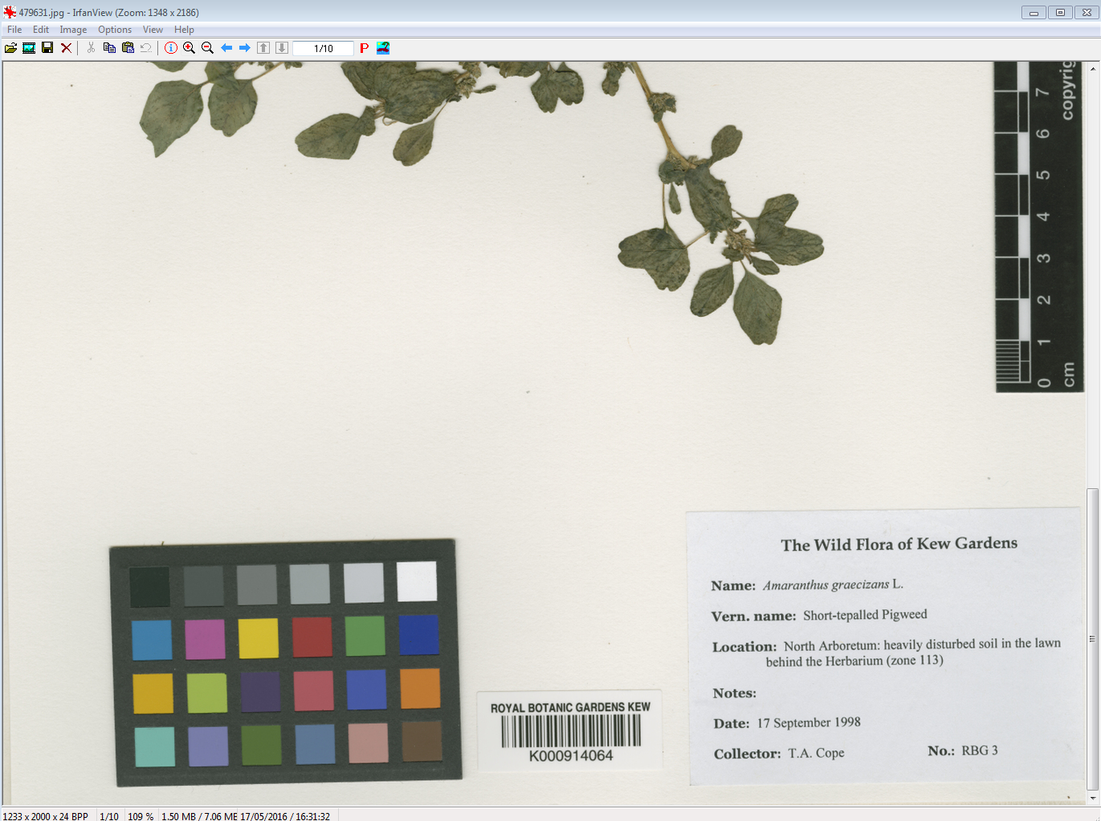
Open up specimen number 479631
Zoom to label – “lawn behind the herbarium”

Slide 9
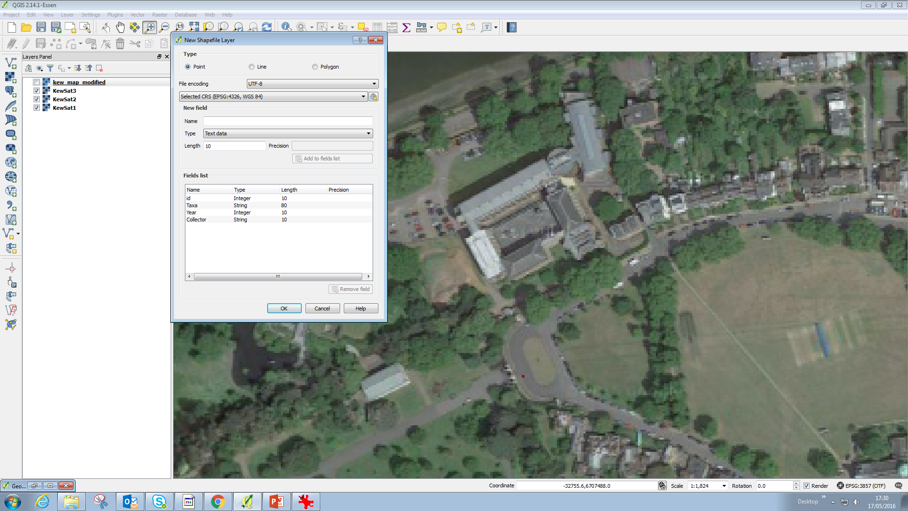
Make a new shapefile
Add Taxa, Year and Collector
Save as “Kew’s Wild Plants”
STOP AND REPEAT!!

Slide 10
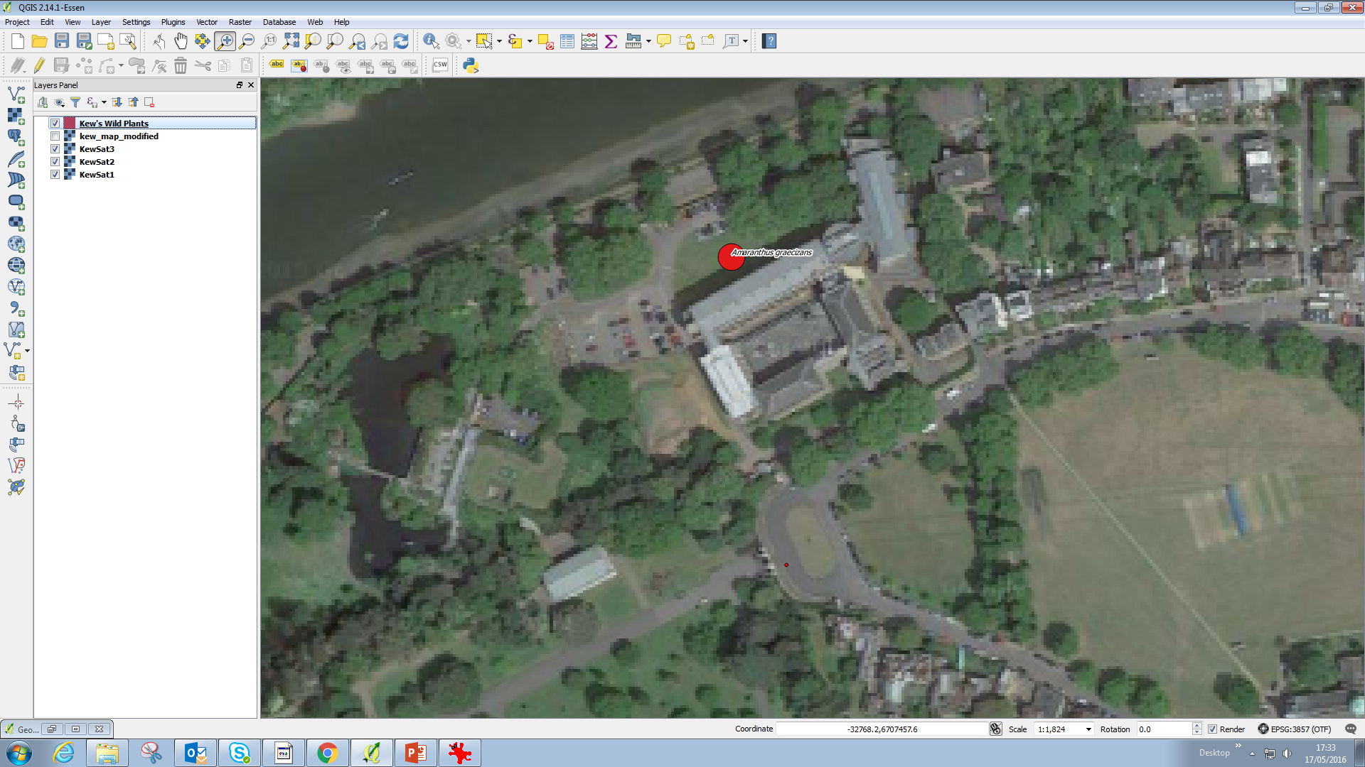
THEY CAN DO THIS THEMSELVES
Add point to behind the herbarium lawn
Add the ID = Herbarium number; Taxa etc
Modify the point to make it big and red
Label, buffer, italics

Slide 11
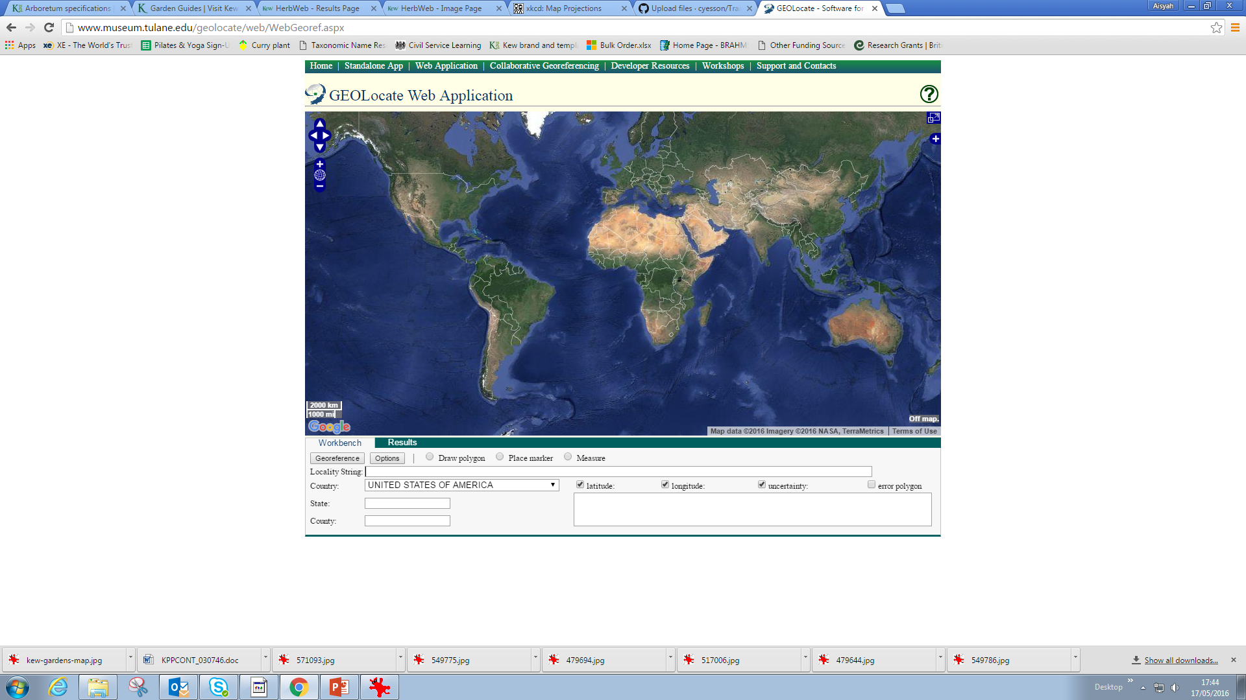
GEOLOCATE

